Slide 1


My Week at Camp
Coding 101
By: Thadeus Hauw
Notes:
Hi Instructor,
Look in this box to find tips and directions for the slides in this presentation template. Presentations are a way for families to understand all the hard work that went into their student’s project this week!
SUGGESTED DAILY DIRECTIONS FOR INSTRUCTOR:
Daily: Have students write one sentence on Slide 2 about something they learned how to do. Sentence frames will help you: “I learned how to make, code, create, assemble, etc.”
Wednesday: Add a class photo on Slide 5, also add photo of student working or a screenshot on Slide 2!
Thursday: Add favorite camp memory and photo to Slide 6.
Friday: Finish “What did I learn this week” on Slide 2. Complete Slides 3, 4, and 7, and add photos or screenshots of the final project. Before Family Showcase, take time to review your students’ presentations for typos.
PRO-TIPS:
Twice daily, remind students to take screenshots of what they’re working on. The screenshots will be stored in the student folder (if it’s set up correctly through Toolkit).
You can find camp photos at http://photos.idtech.com/IDTC! (Let the students know your location and the dates of camp so they can find photos quickly) You can also find photos through the bookmark bar on your web browser.

Slide 2


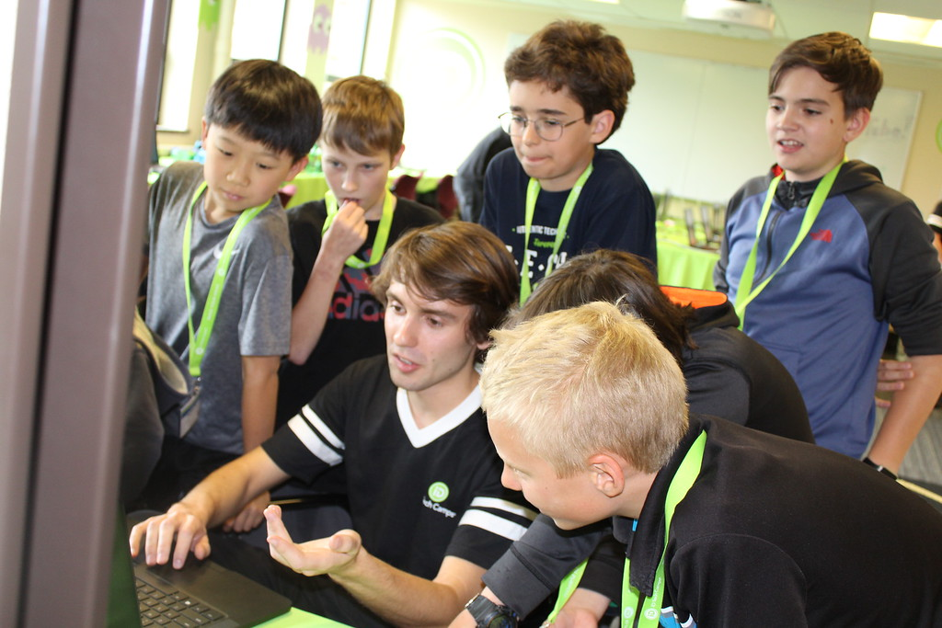
What I Learned This Week
I learned about if/then statements.
I learned how to make my own page on the internet
I learned _ _ _ _.
Notes:
DIRECTIONS:
Students list at least 3 things they learned in this course. They can add more sentences if they wish.
The verb should vary between sentences (I learned about if/then statements; I learned how to code a loop; I created a circuit, etc.)
SENTENCE FRAME EXAMPLES:
“I learned about __________.”
“I coded a ________”
“I built a __________”
“I designed a _____________”
“I created a ______________”
IMAGE SUGGESTION:
Screenshot of student’s code, level, model, etc.
Photo of them working on something more hands-on (Robots, LittleBits, Film Camera, etc)

Slide 3
My Final Project
My project is called _ _ _ _.
My favorite part of my project is _ _ _ _.
The hardest part of my project was _ _ _ _.
Notes:
DIRECTIONS:
Students will write out 3 sentences about their final project. They can use these sentence frames or write their own!
IMAGE SUGGESTIONS:
Student should use screenshots from their student folder here. If you have photos of a student’s project, you can use that instead.

Slide 4
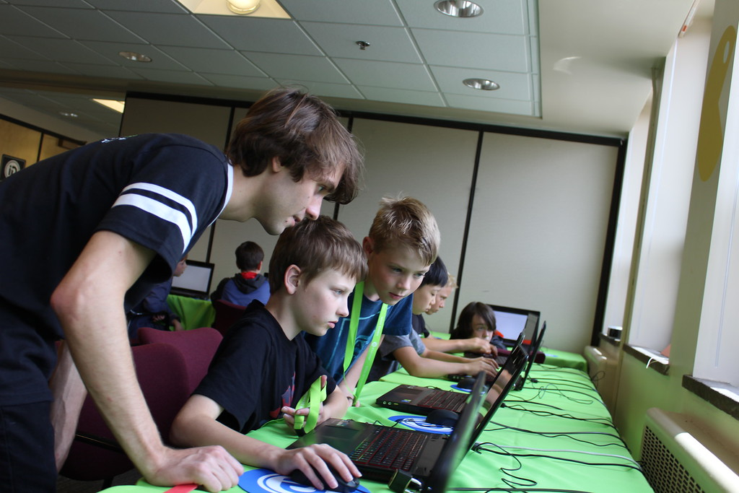
How was
the process?
The most challenging part of my project was _ _ _ _.
The part of my project I'm most proud of is _ _ _ _.
Notes:
DIRECTIONS:
Students reflect on the process of creating their final project.
IMAGE SUGGESTIONS:
Student should use screenshots from their student folder here. If you have photos of a student’s project, you can use that instead.

Slide 5
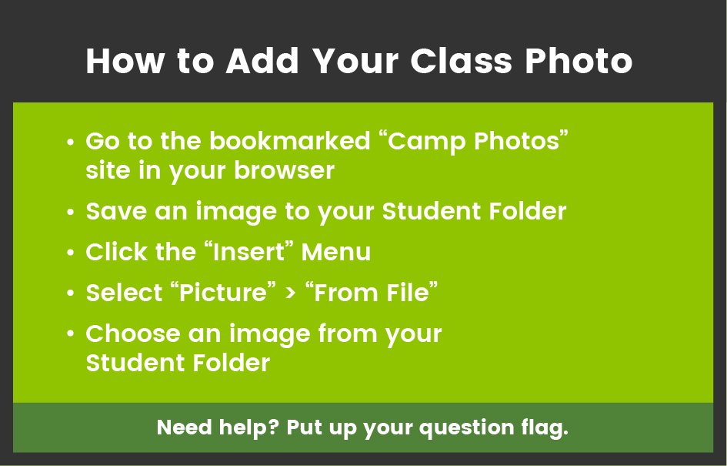
Who was
in my
class?
Location
Date of course
Notes:
DIRECTIONS:
Have students find their class photo (http://photos.idtech.com/IDTC) and save it to their folder.
PRO-TIP: It will save time to find your specific location and the date of the week before having students browse for photos!
TO CHANGE PHOTO: INSERT > PICTURE > FROM FILE > SELECT PHOTO FROM STUDENT FOLDER

Slide 6
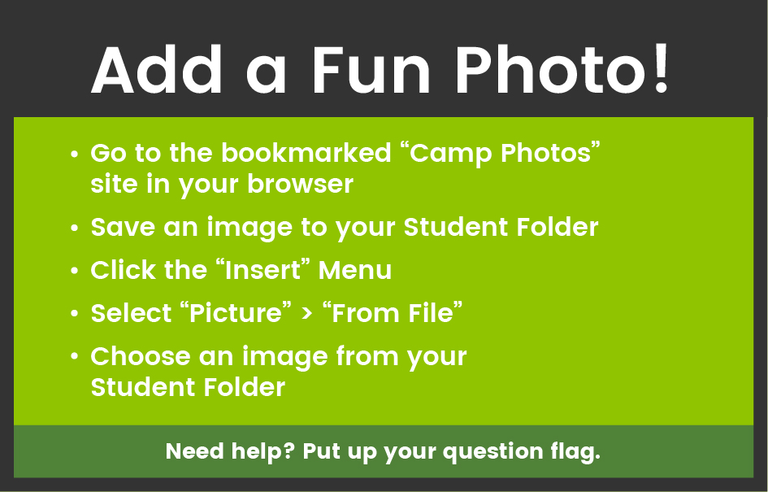
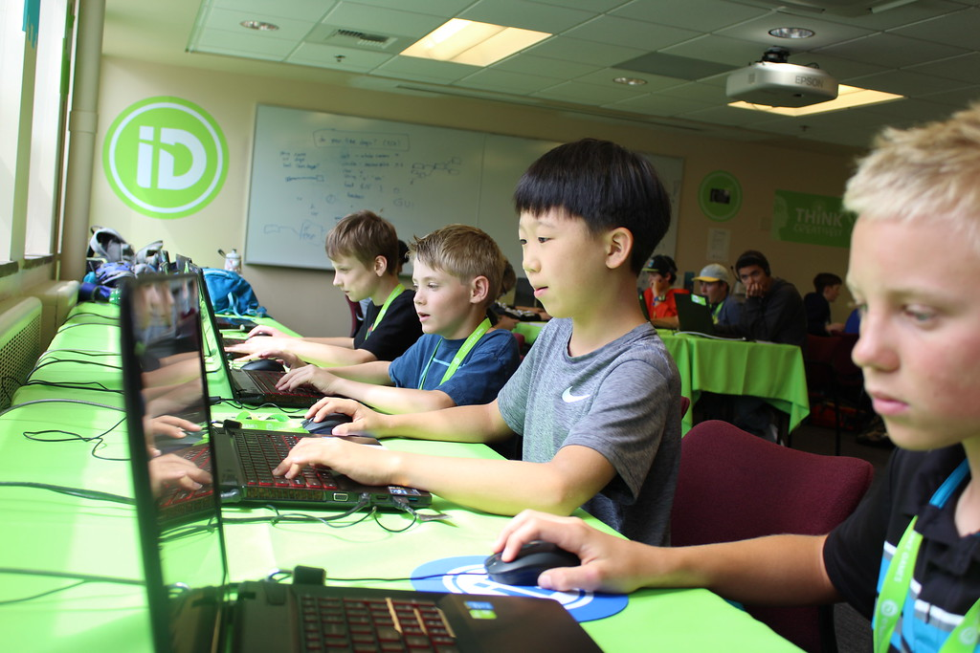
What was my
favorite camp
memory?
My favorite camp memory was learning how to code on Brackets
Notes:
DIRECTIONS:
Have students find a photo of themself (http://photos.idtech.com/IDTC) and save it to their folder.
PRO-TIP:
On Thursday or Friday, you can do a class brainstorm to remember funny or amazing things that happened during the week. Make a list and have students choose 1-2 things to put on their slide.
IMAGE SUGGESTIONS:
Photos that show the student smiling or engaging are most pleasing to families!

Slide 7
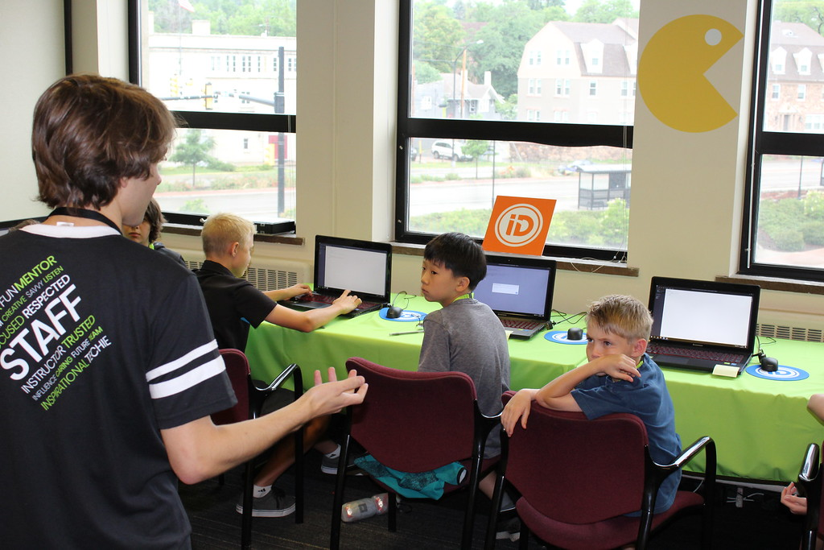
What’s next?
I'd like to learn more about how to add a video or ad to my page
I plan to continue my project by practicing at my house
Notes:
DIRECTIONS:
Encourage students to think about how they will continue learning after camp. They can use these sentence frames or write their own.
IMAGE SUGGESTIONS:
Either screenshots of the student’s work or camp photos of them engaged in learning will work here!

Slide 8



Questions?
Notes:
DIRECTIONS:
This is the end of the slideshow!
It encourages the Family Members to ask questions and learn more about their student’s project.
PRO-TIP
This is a visual cue for YOU that the family is done looking through the presentation and might need some help transitioning to project viewing.

